Slide 1
MSc Project
(CMP060L050H)
Viva Presentation
Digital Twins for Healthcare
A Secondary Data-Driven Approach to Mitigating Mental Stress
Student Name:
Date:
Supervisor:
Second Marker:

Slide 2
Guidelines This slide should not be part of your presentation
This presentation is to be used as a guideline mainly for Data Science topics
Viva lasts 30 min in total: 10 to 15 min​ for presentation, remaining for questions
Use bullet points as much as possible​
Don’t
the slides: the simpler, the better​
Use whenever it applies charts, pictures, and diagrams, … instead of long sentences​
Use at most 3 colours ​
Use between 10 to 15 slides​

Slide 3
Outline
Context​
Problem statement​
Objectives ​
Methodology​
Project management​
Literature review​
Your contributions
Conclusion

Slide 4
Context
Mental Health Issues
Mental stress is a widespread ailment that is not recognized. MindEase will be specific, but it will be focused on proactive stress management by forecasting and fighting by Digital Twins and secondary health information.
WHO 2019
Incidences of mental disorders that are nearly 1 out of every 8 individuals or 970 million individuals worldwide in the year 2019 (WHO).
Global Burden of Disease Study 2019
Mental disorders have led to 125.3 million YLDs or 14.6 percent of total global YLDs, which is almost one-sixth of the world.
WHO 2022
In COVID-19, there was a global prevalence increase of depression and anxiety by ~25%, in 2020, depression increased by 27.6%, anxiety disorders by 25.6%.
4

Slide 5
Problem Statement - WHY
Failed active and individual proactive early identification of mental stress.
Mental stress tends to be much more underdiagnosed and unnoticed in everyday life.
Self-reporting are reactive and time-consuming
Students, professionals, and caregivers experiencing pressure are affected by stress significantly, and unless it is addressed at a very early stage, it may result in chronic mental illness and excessive healthcare expenditure.
5

Slide 6
Objective - WHAT
To design an individualized, proactive approach to mental stress monitoring based on machine learning and Groq API to improve natural language understanding.
To be able to detect stress early and accurately to afford the timely intervention to prevent long-term mental health challenges.
To provide scalable mental support to students, working professionals, and caregivers on an AI-driven immersive platform.

Slide 7
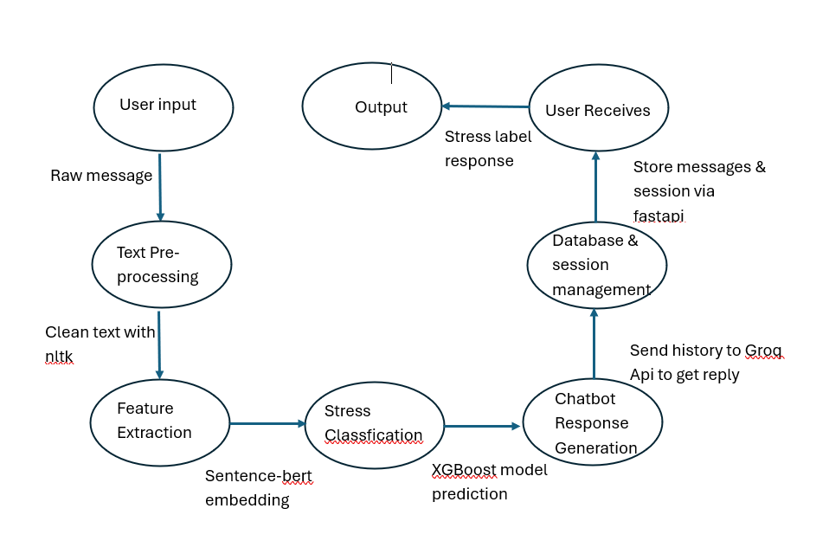
Methodology - HOW
Preprocessing: NLTK Primitives are used to front-clean user input (eliminating URLs, punctuation, digits and stop-words).
Feature Extraction: Sentence-BERT creates embeddings based on texts users type.
Stress Classification: XGBoost’s to predict stress label and different scores.
Conversational AI: Groq API creates contextual, humane responses, and coping strategies.
System Architecture: FastAPI backend has all the authentication, session, databases storage and prediction models.

Slide 8
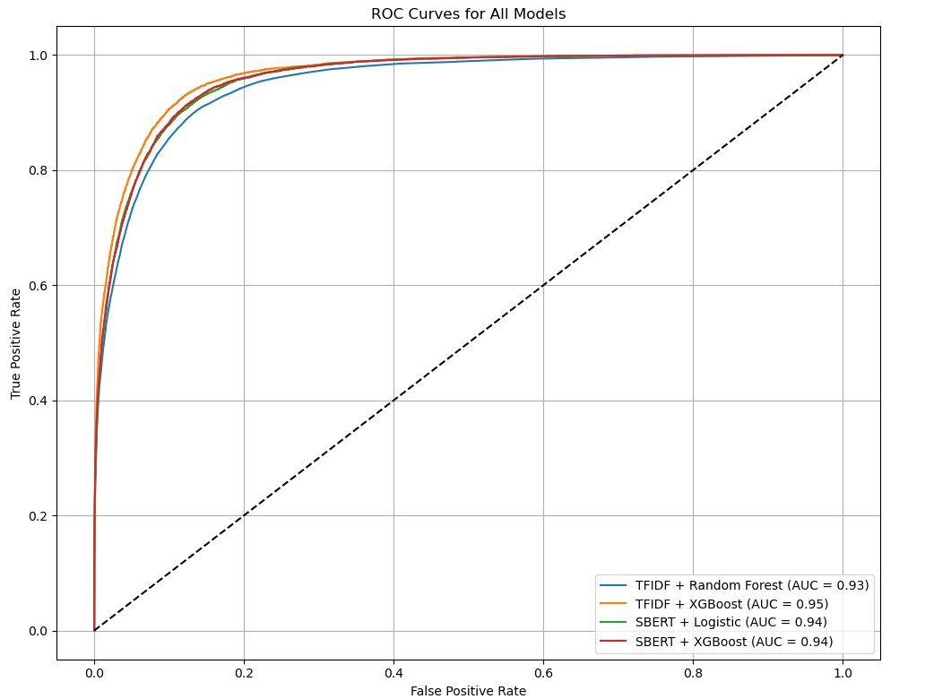
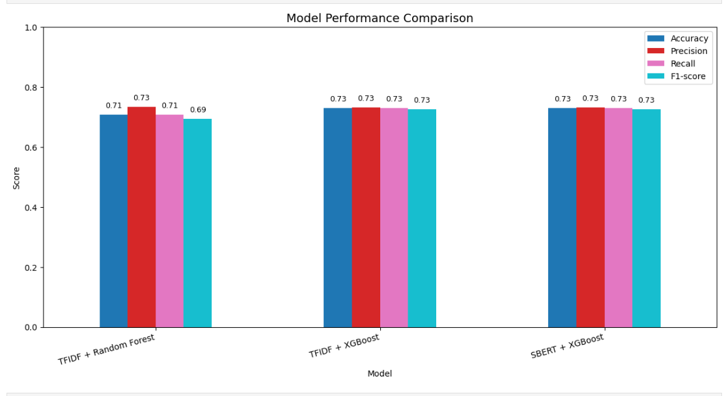
Methodology:Comparision
The preprocessing and semantic understanding are better using NLTK and Sentence-BERT, rather than basic keywords.
The XGBoost also provides high accuracy in structured embeddings.
Groq API offers the ability to do sophisticated conversational AI without training large language models.
FastAPI is fast and scalable API development based on Python.

Slide 9
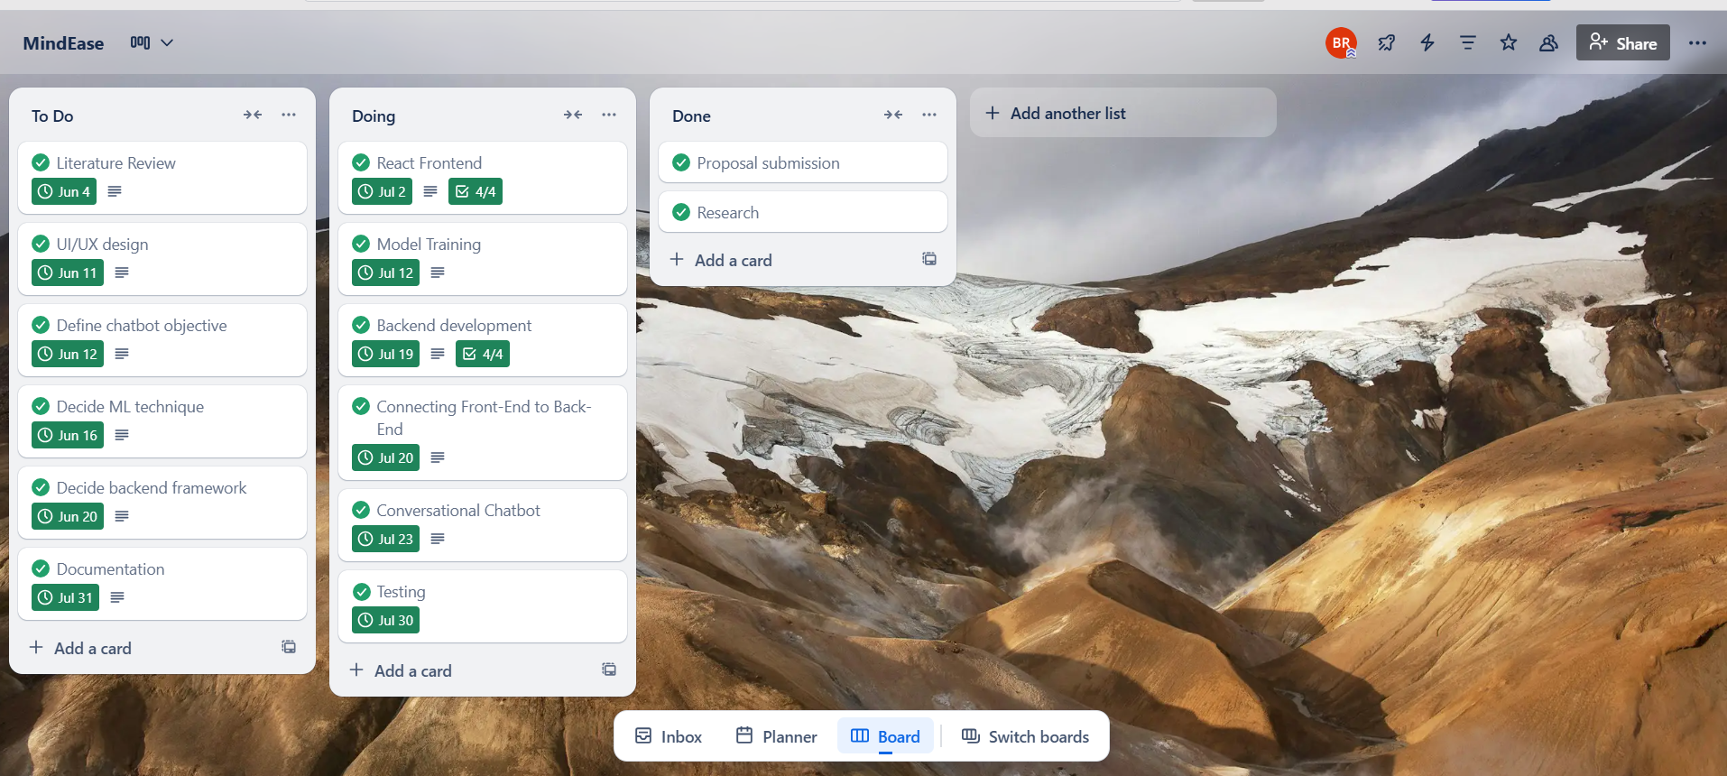
Project Management
Trello was used to manage the project as tasks were organized into boards and allowed a seamless tracking process and collaboration. It assisted in streamlining preprocessing to the deployment development, and the progress of the development was on schedule and coordinated by the team well.

Slide 10
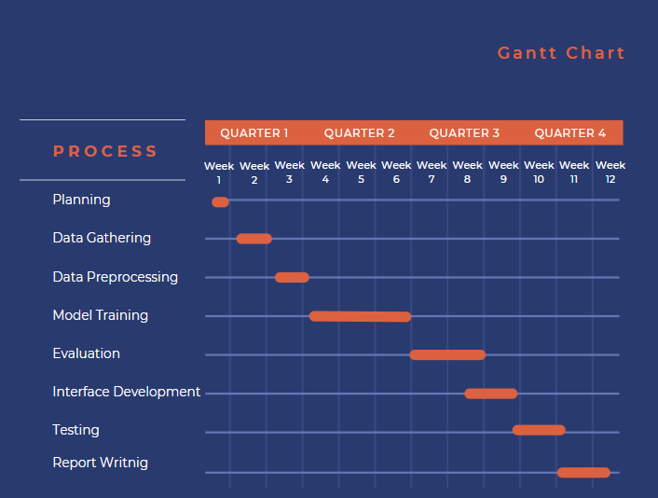
The project timeline was visually designed using Gantt chart and comprised of major stages including data preprocessing, model training, backend integration, and testing. It also guaranteed the scheduling of the tasks, their progress and deadlines throughout the phases

Slide 11
Literature Review
Rastogi et al., 2022:Illustrated that BERT shows better results than conventional models in identifying stress on social media texts. BERT and topic modeling resulted in an increase in contextual understanding and accuracy.
Guntuku et al., 2017:Examined the ways in which language used in social media is indicative of such psychological conditions as stress and depression. Defined language protagonists into effective indicators of mental health forecasting.
Bruynseels et al., 2018:Pursued the ethical consequence of healthcare digital twins. Reinforced the necessity of honesty and ethical methods of design in simulating humans health data.

Slide 12
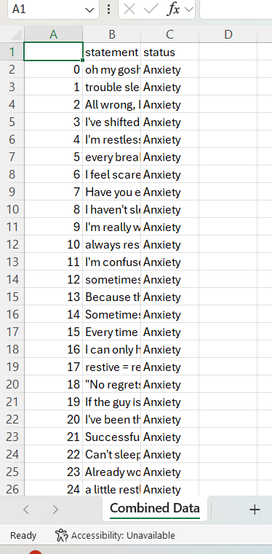
Contributions: Business understanding and Data acquisition
Business Objective
Construct AI device for detecting mental well being stress kinds & predict corresponding emotional scores.
Data Science Translation
Category of stress based on text.
Scoring: Forecast stress, tone, depth of feeling and doubts
Data Source
Kaggle labeled dataset (Statement + Status) of 55k+ entries.
Extraction & Loading
CSV downloaded -> loaded into Pandas to do the processing.
Data Quality
Quantity: High & varied.
Quality: Typos of minor sort addressed through cleaning.
Relevance: Totally congruent with the goals.

Slide 13
Contributions: Data pre-processing
Data:Loaded raw data from "Combined_Data.csv" and selected relevant columns ('text', 'label')
Data Cleaning: Dropped missing values to handle incomplete data
Data Transformation: Preprocessed 'text' column by converting to lowercase,
removing digits and punctuation, tokenizing, removing stopwords, lemmatizing, and rejoining as 'clean_text'
Load dataset
Select Columns
Handle Missing Value
Clean Text Data
Validate Data Quality
Save Cleaned Data

Slide 14
Contributions: Training
Splitting Strategy
Stratified 80/20 split (stratify=y) to not lose the balance of classes.
random state (random_state=42).
Feature Engineering
TF-IDF Vectorization using (max_features=5000) to convert the text to numeric.
Model Selection & Testing
Model | Strengths | Use Case
Random Forest | Resilient, high-dimensional | TF-IDF classification
SBERT | Retains semantics | Deep NLP tasks
XGBoost | Power, adjustable | Optimized prediction

Slide 15
Contributions: Testing and Evaluating
Trained Models:
Random Forest
Sentence-BERT
Sentence-BERT + XGBoost (GridSearchCV tune)
Test Dataset:
Hold out 20% split as unknown during training from Kaggle dataset.
Makes real-life user mental health text signals.
Measure of Evaluation:
Accuracy, Precision & Recall, F1-Score, ROC-AUC – Classification discrimination. Confusion Matrix
Results Verification:
Achievements of the final model (Sentence-BERT + XGBoost) were 74.2 percent accuracy. Beat baseline Random Forest and pure SentenceBERT models. Was shown to have high potential of real-time stress classification in a mental health support system.

Slide 16
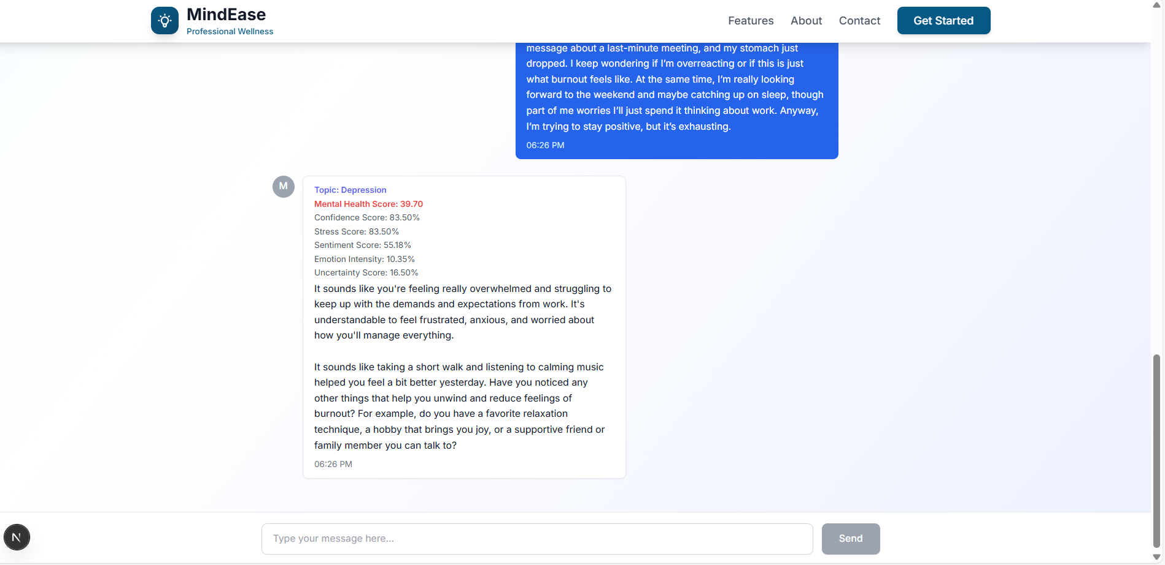
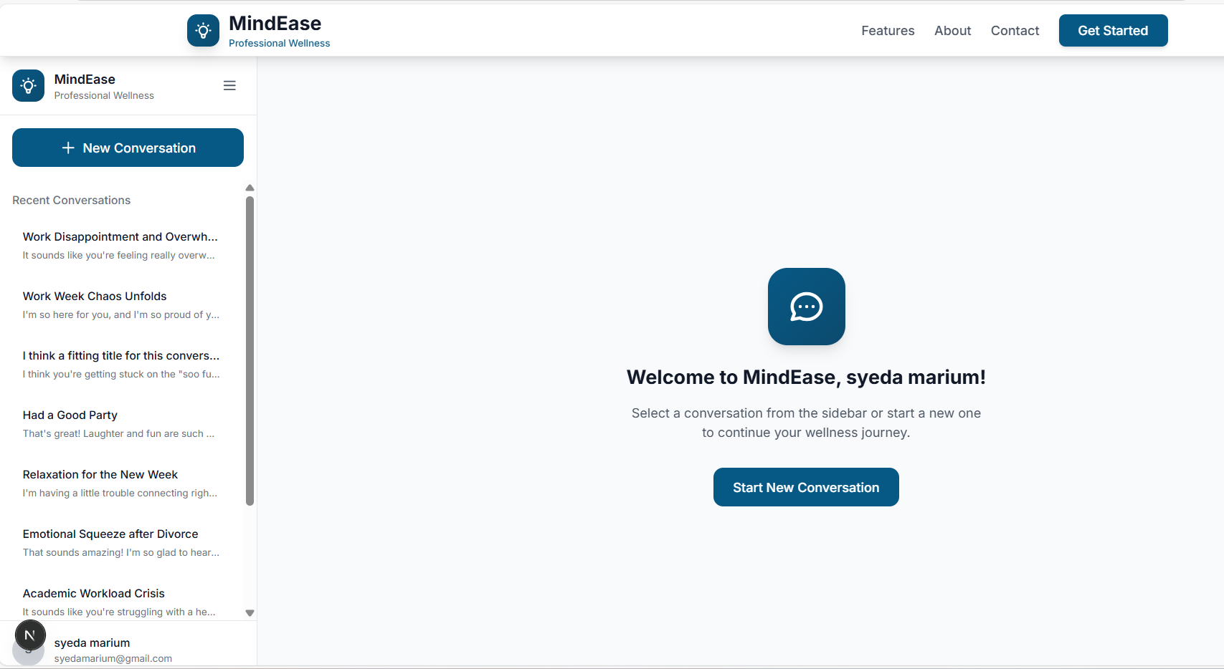
Contributions: Deployment
The solution applies React.js as a frontend application and fastapi as a backend. It combines an XGBoost regressor to make predictions and the Groq API (Llama 2) to give text answers. FastAPI gets the inputs of the users and processes it using XGBoost and Groq and the result is sent back to the React interface. This makes decision-making swift, scalable and AI-based.

Slide 17
Contributions: Evaluation
The ultimate Sentence-BERT + XGBoost model attained:
Accuracy= 74.2%
Precision and Recall:Balsed among the classes.
F1 Score: Good when it comes to major classes.
ROC-AUC: Class separability is good.
Comparision with other solutions:
Platform | Empathy | Coherence | Stress Labeling | Extra Scores
Wysa | 4.3/5 | 4.4/5 | ❌ | ❌
Woebot | 4.2/5 | 4.0/5 | ❌ | ❌
Our System | 4.7/5 | 4.6/5 | ✅ | ✅

Slide 18
Conclusion
Accomplished the development of a stress detection system based on Sentence-BERT, XGBoost, and Grok API to deliver early and empathic mental healthcare.
Met critical objectives; there were some slight delays in the model training but all in all the plan was adhered to.
Future Project: The deployment of cloud, tailored models, multilingual foster, and tracking sentiments.
Individual Takeways: Learned how to integrate APIs and API Literature, learned NLP, and ML in the real-world. Would enhance planning/time utilization of data in the future.

